Slide 1
REMATRICULA ON LINE 2018

Slide 2
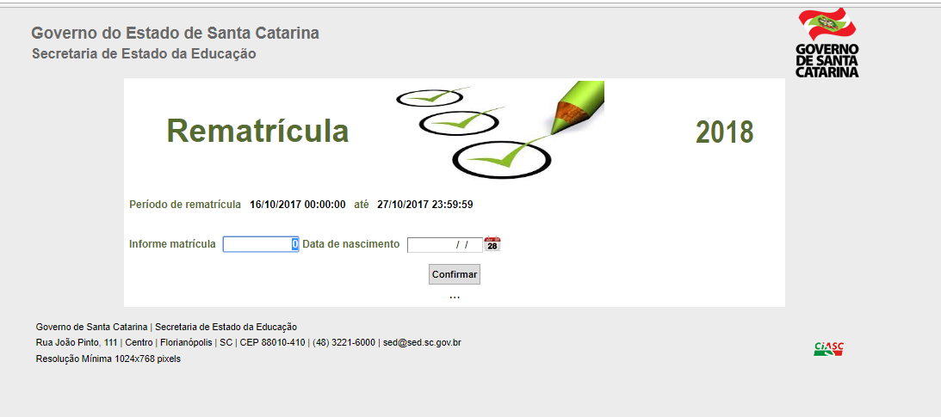

Slide 3
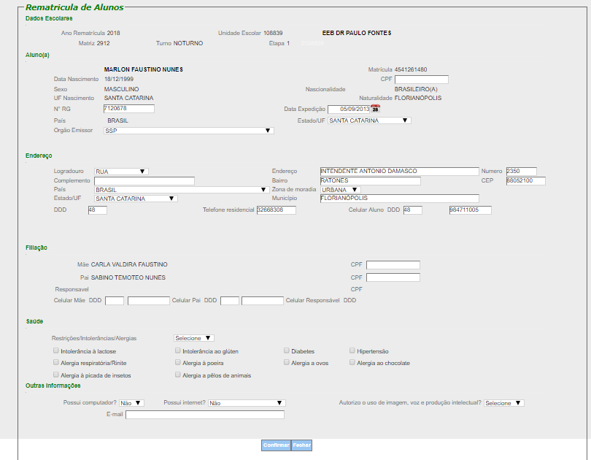

Slide 4
